Slide 1
Survey on innovation
October 2017

Slide 2
Why did we conduct this survey ?
Uptake of innovation funds is typically low in Malta. Why are innovation funds not being used ?
Does small business think that innovation means inventing something ? Simply R&D ?
What innovation if any is employed mostly by SMEs in Malta ?
Does innovation in small business pay off ?
How can GRTU do more?
Methodology :
209 respondents online by invitation.

Slide 3
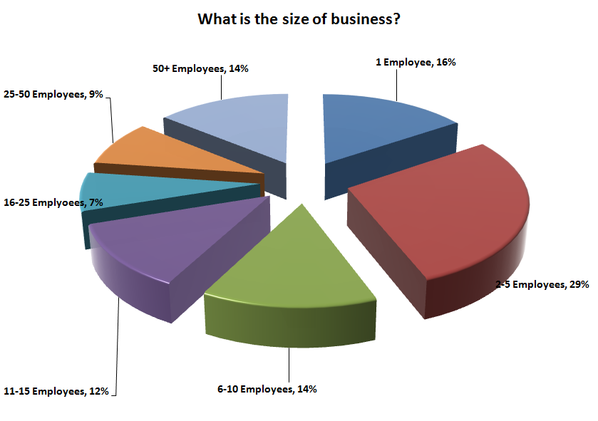

Slide 4
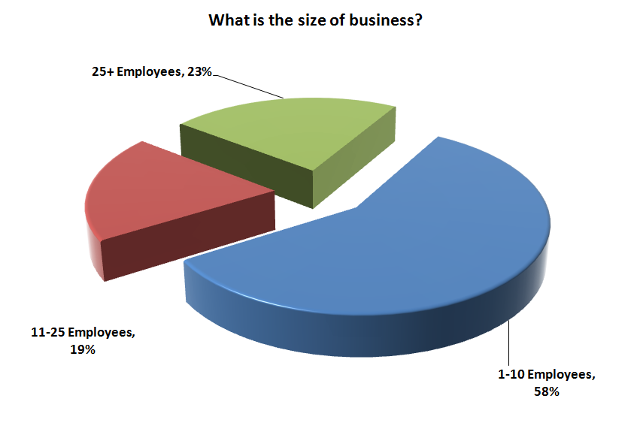

Slide 5
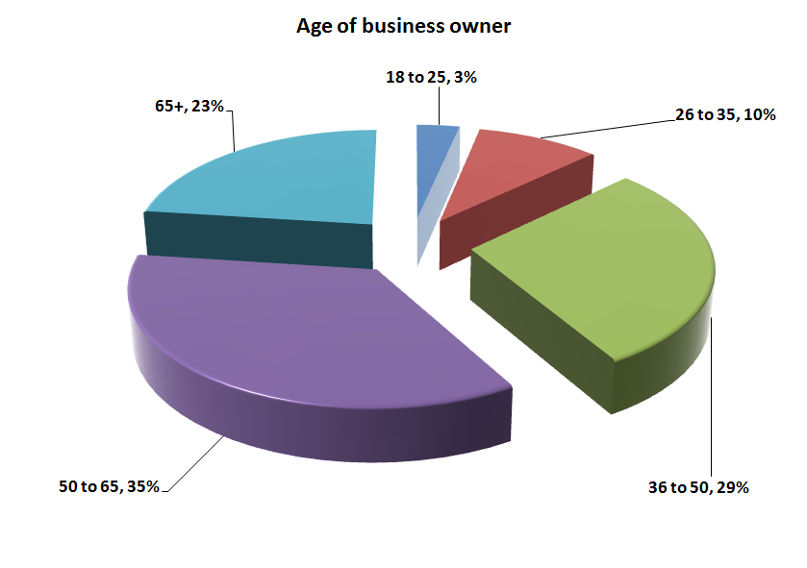

Slide 6
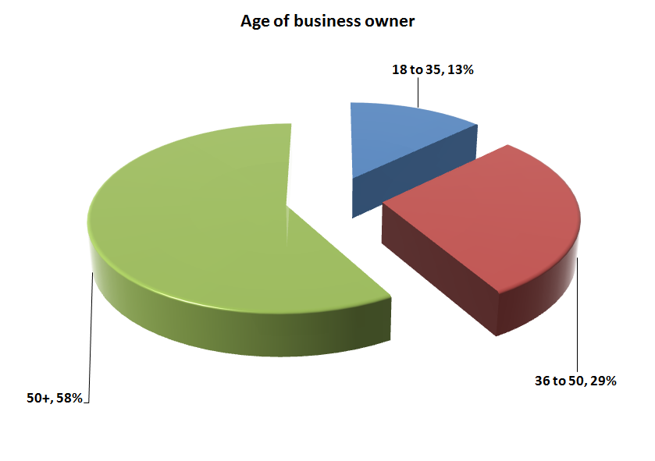

Slide 7
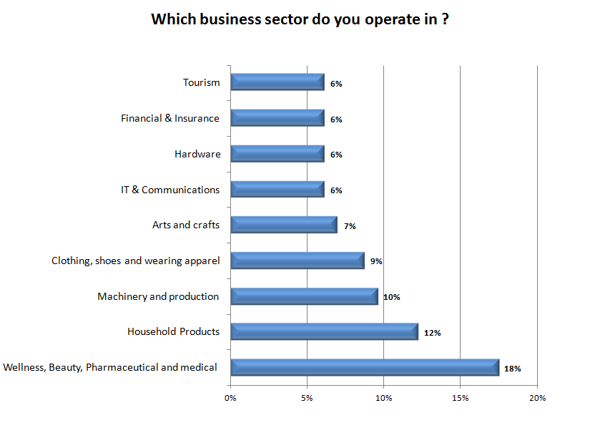

Slide 8
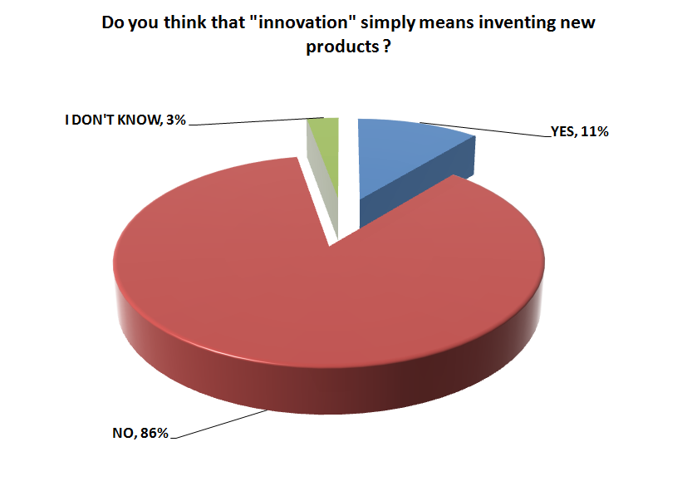

Slide 9
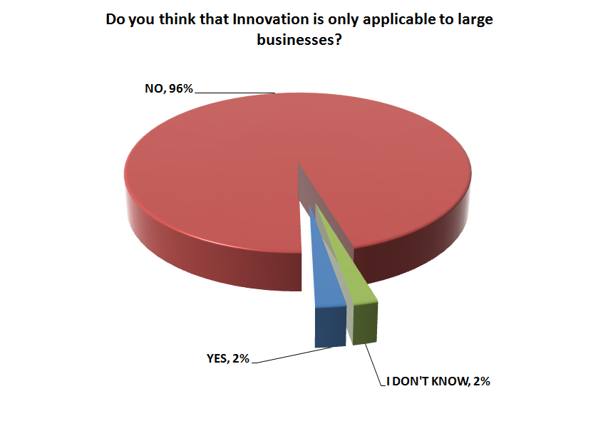

Slide 10
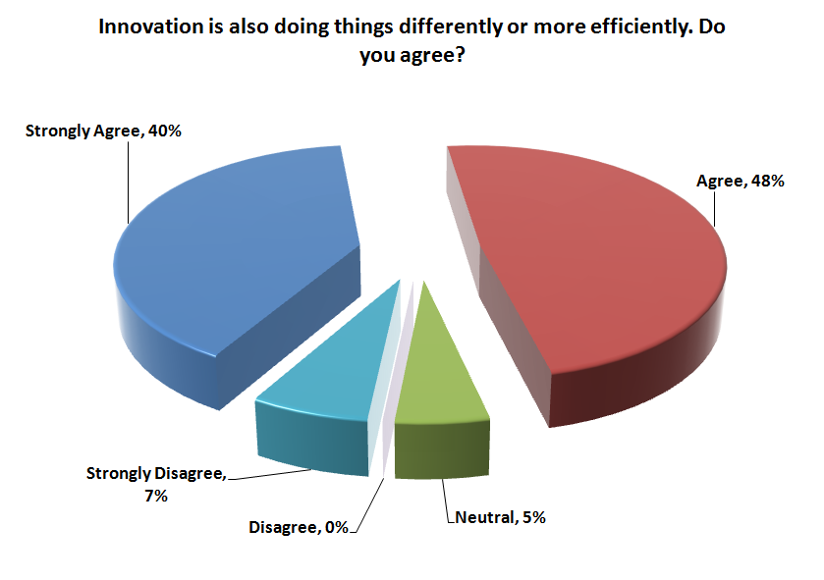

Slide 11
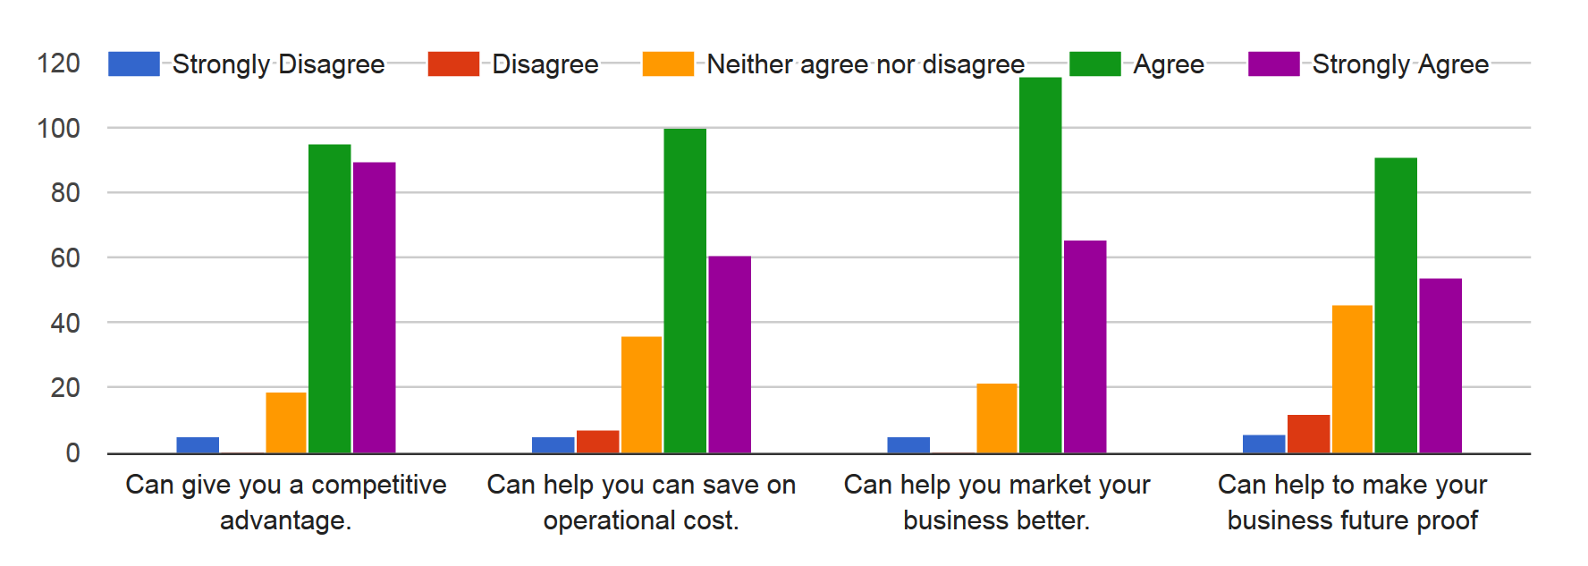
Why do you think it is important to do things differently
and be innovative in your business ?

Slide 12
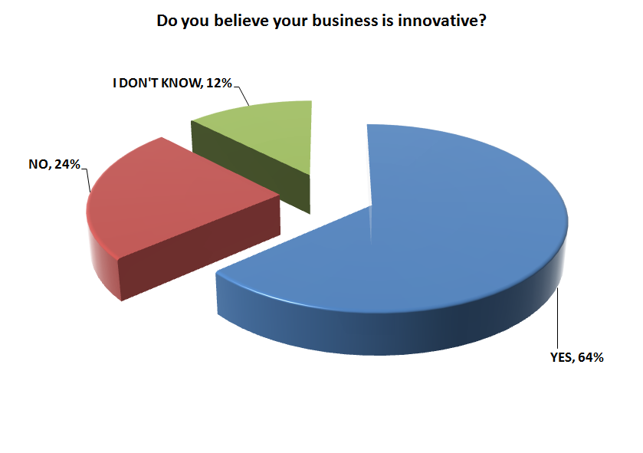

Slide 13
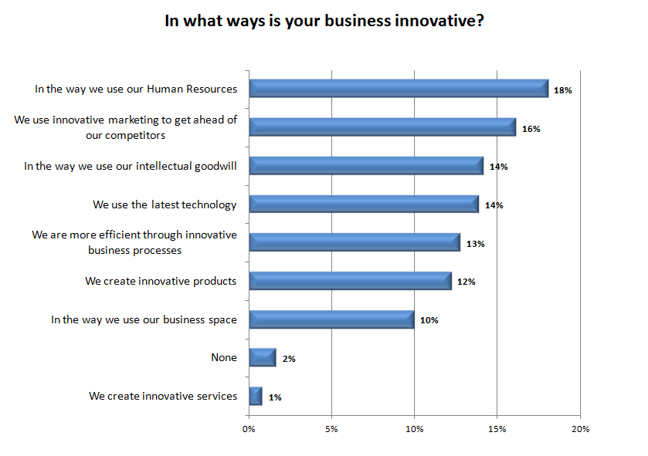

Slide 14
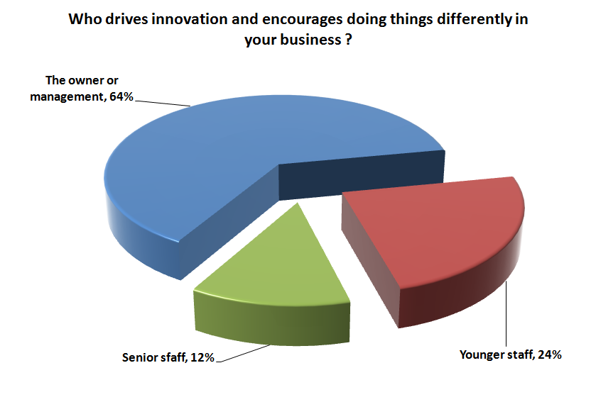

Slide 15
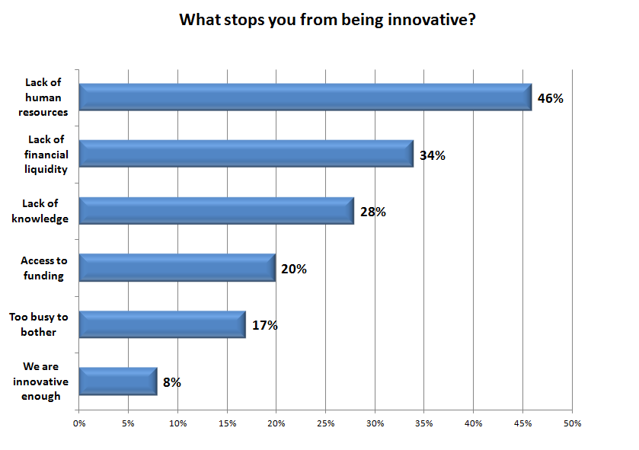

Slide 16
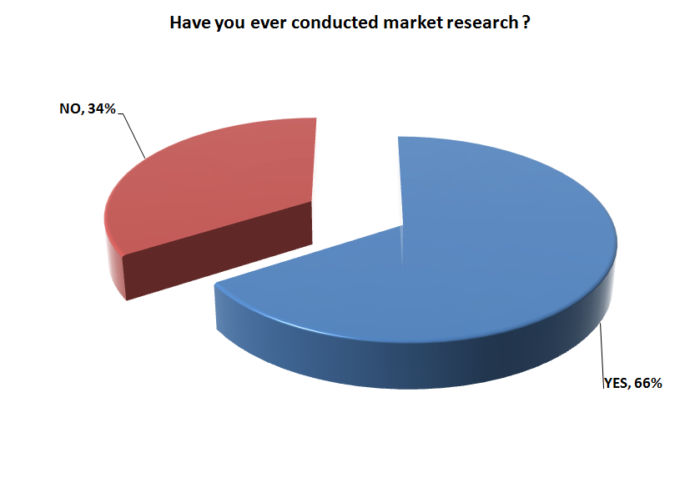

Slide 17
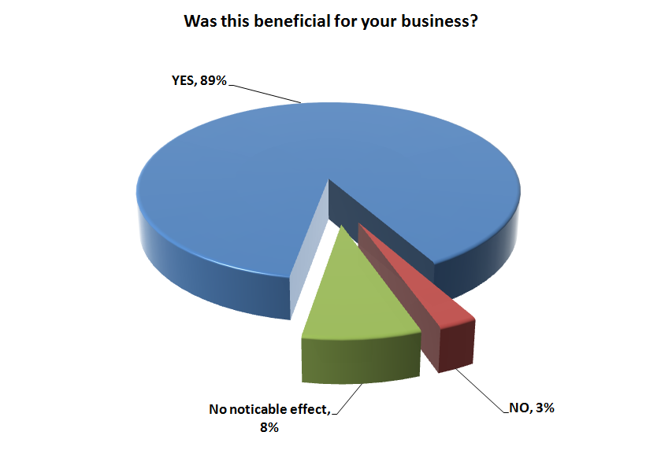

Slide 18
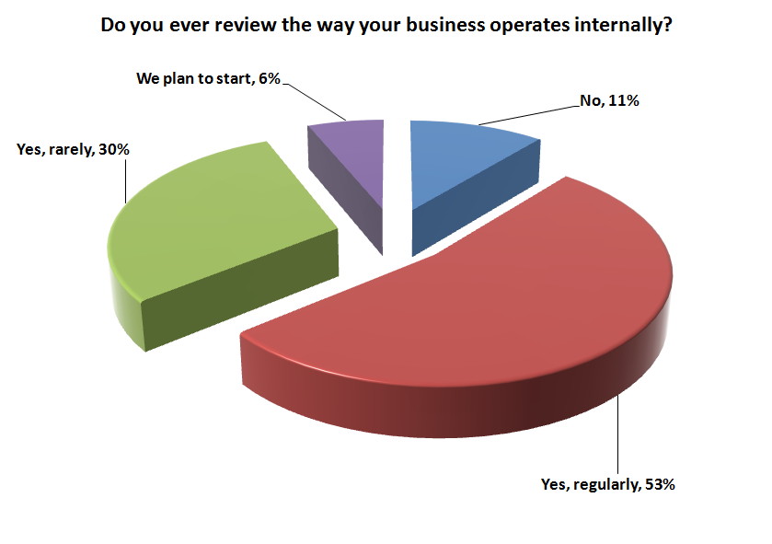

Slide 19
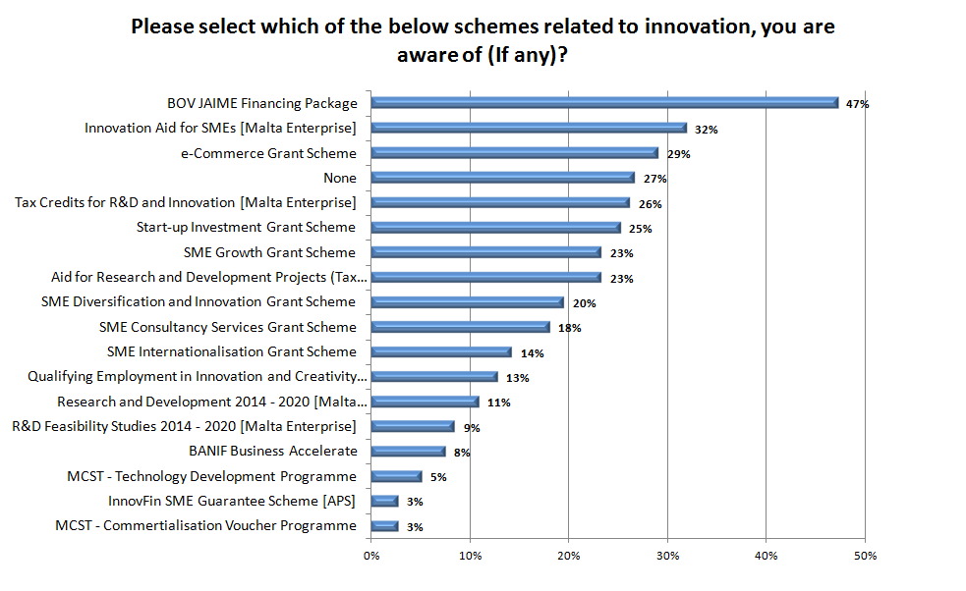

Slide 20
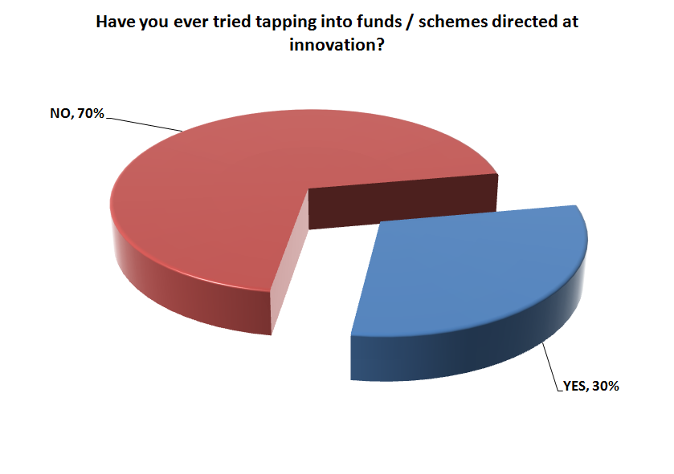

Slide 21
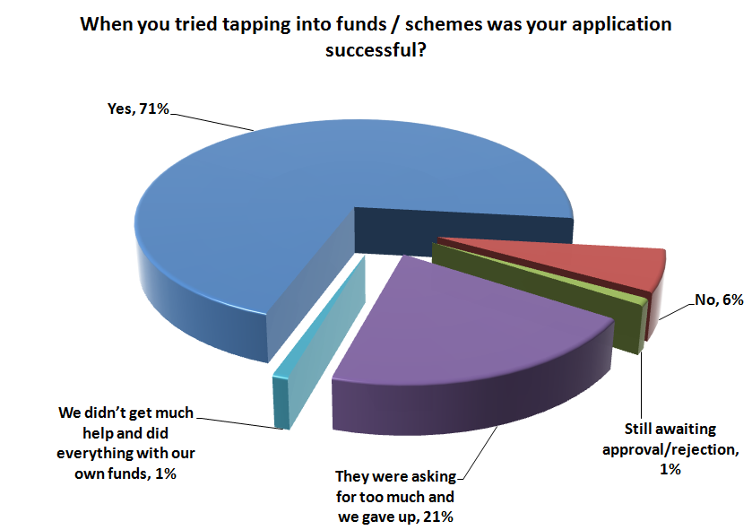

Slide 22
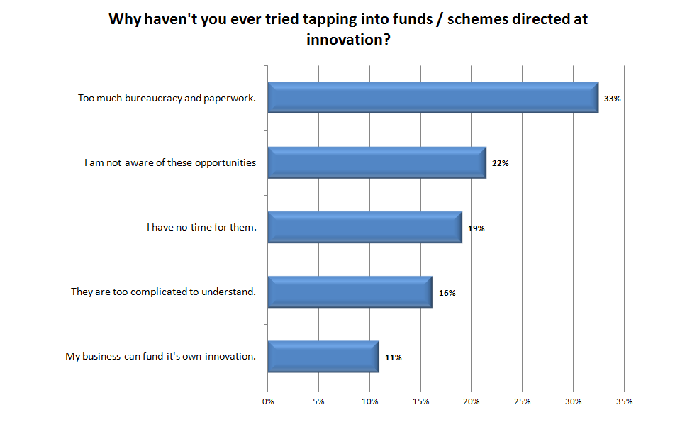

Slide 24
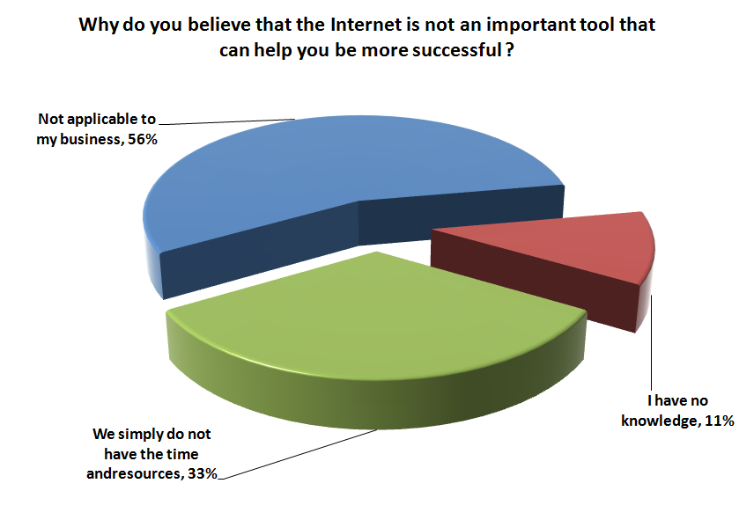

Slide 25
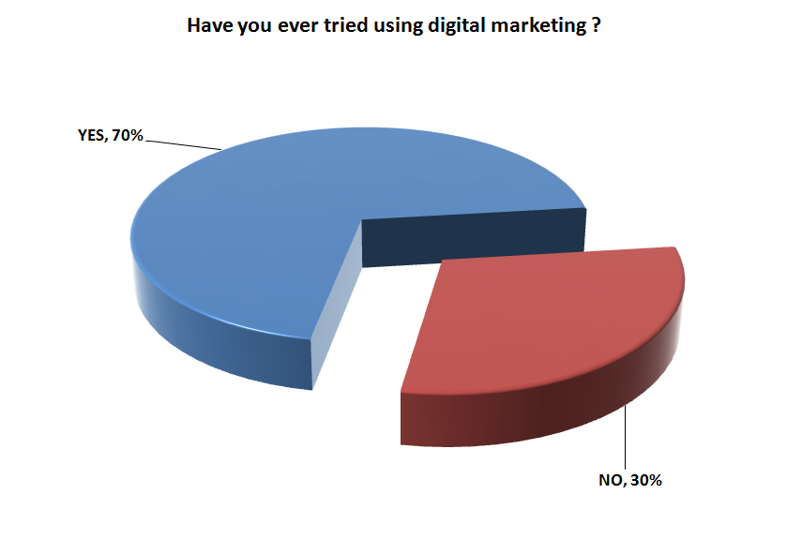

Slide 26
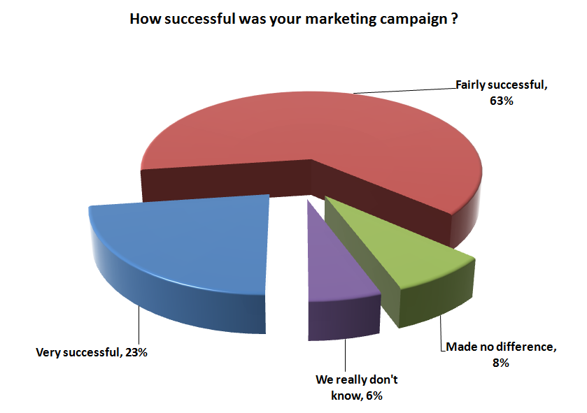

Slide 27
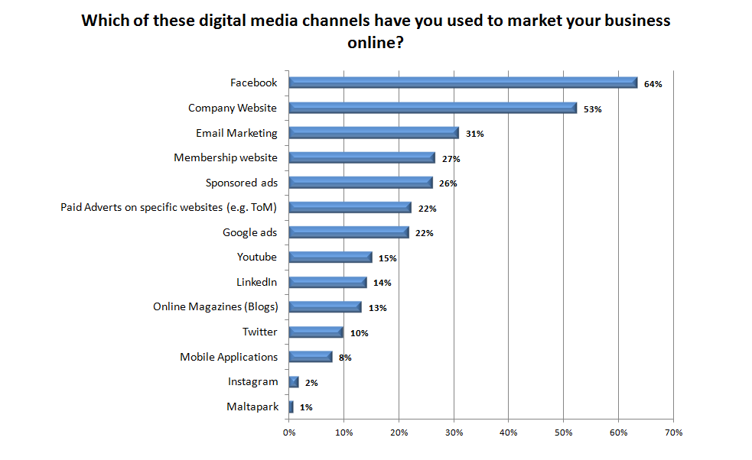

Slide 28
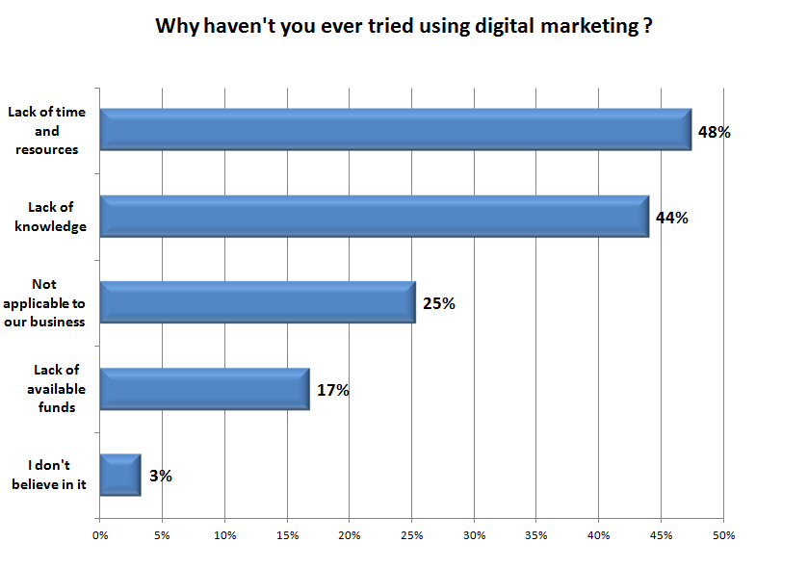

Slide 29
Some examples of innovation is SMEs
Selling products through other channels such as online.
Purchasing products through online .
Electronic invoicing to save time and resources
Shared or sub-contracted delivery systems.
Encouraging workers to work from home.
Planning for and accessing niche markets abroad.
Using technology for meetings.
Analyzing and understanding your clients and targeting your marketing.

Slide 30
Some examples of innovation is SMEs
Marketing through new channels such as social media.
Using social media to communicate with clients more effectively.
Outsourcing processes that are not cost effective such SAAS – Cloud computing.
Training your staff to use the latest tools.
Using available funding instruments.
Partnering with other companies even competitors.
Using foreign workers (abroad) to minimize costs and solve the current HR problems.

Slide 31
THANK YOU
marcel.mizzi@grtu.eu

